Slide 1
Add A Line to a Current PO

Slide 2
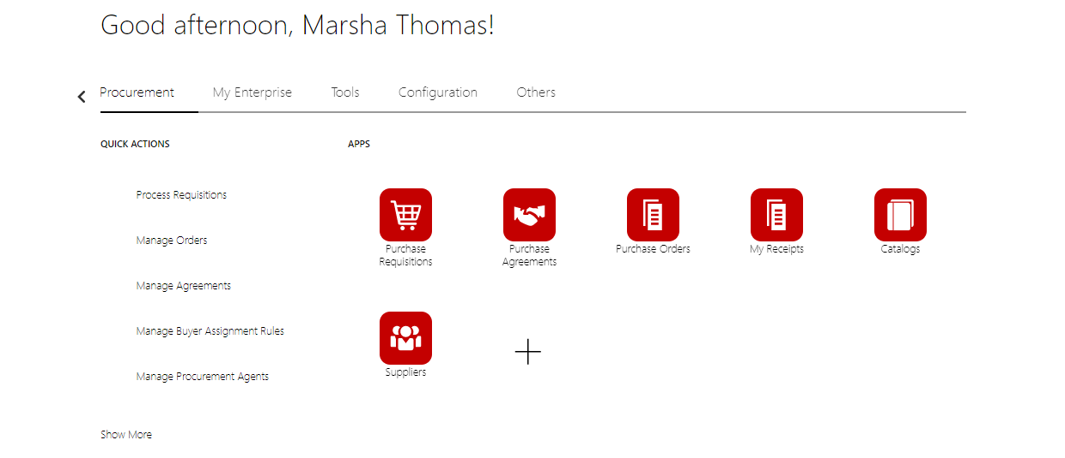
Create a NEW Requisition for only the lines you need to Add

Slide 4
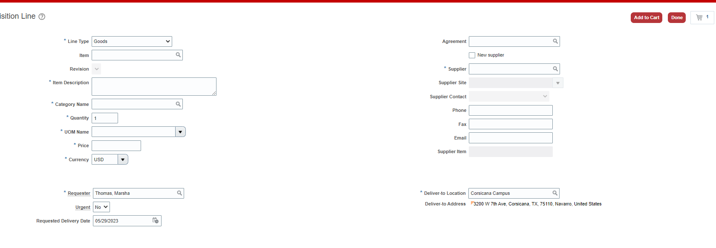
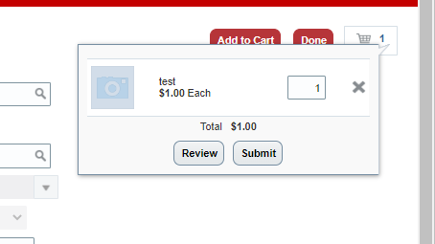
Enter the lines you need to ADD to a current PO
Click Review

Slide 5
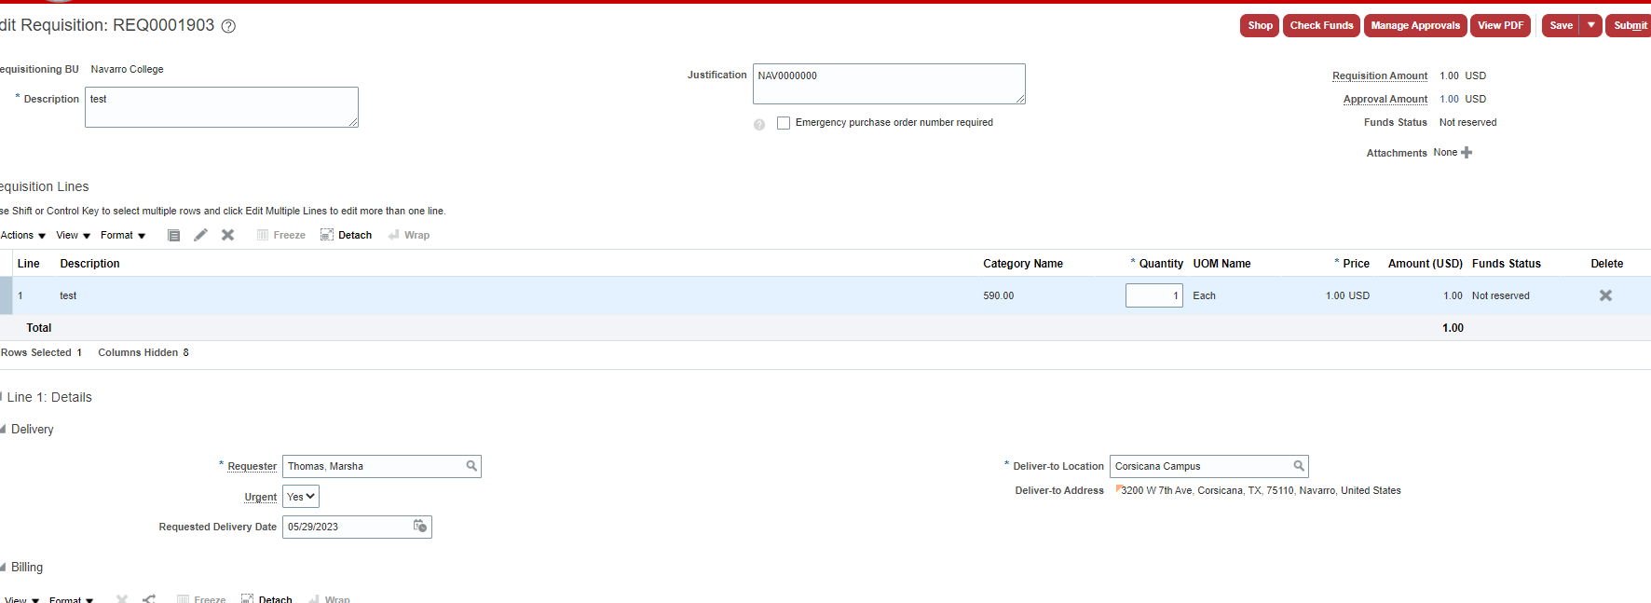
In the Justification Box – put ONLY the PO number you want me to add this/ these lines too.
Urgent Drop Box – YES
Check funds – Submit as normal - This will create a change order that will go thru Manager Approvals

